Slide 1
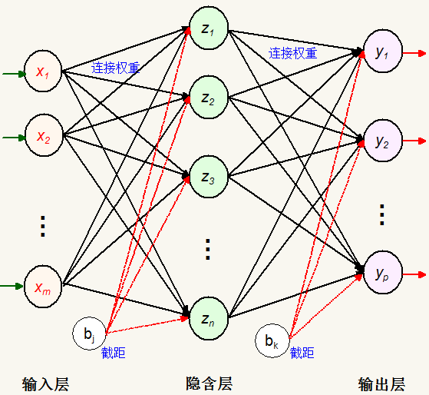
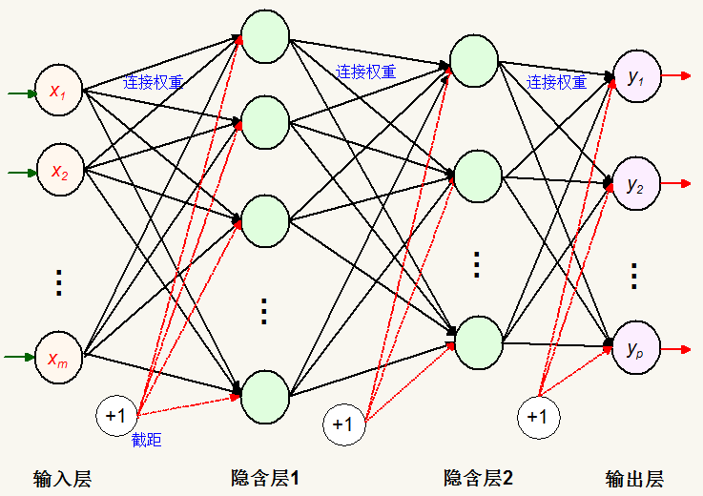
模块化问题
3层结构BP神经网格
4层结构BP神经网格

Slide 2
3层结构类定义问题
class BpNet
{ public:
BpNet();
virtual ~BpNet();
public:
double ih_w[BpInNode][BpHideNode]; //隐含结点权值
double ho_w[BpHideNode][BpOutNode]; //输出结点权值
double Hideb0[BpHideNode]; //隐含结点阀值
double Out_b0[BpOutNode]; //输出结点阀值
double rate_ih_w; //权值学习率（输入层-隐含层)
double rate_ho_w; //权值学习率 (隐含层-输出层)
double rate_Hideb0; //隐含层阀值学习率
double rate_Out_b0; //输出层阀值学习率
double In_x0[ BpInNode]; //输入向量
double Hides0[BpHideNode]; //隐含结点状态值
double Outy0[ BpOutNode]; //输出结点状态值
double Outyd[BpOutNode]; //希望输出值
double out_Er[BpOutNode]; //输出结点的校正误差 希望输出值与实际输出值的偏差
double hideEr[BpHideNode]; //隐含结点的校正误差
double totalErr; //允许的总误差
public:
void __fastcall winit(double w[],int nn); //权值初始化
void __fastcall BpInitNetFunc(); //参数初始化
void __fastcall BpNetTrainFunc(double InSam[trainsample][BpInNode],
double OutSam[trainsample][BpOutNode]); //Bp训练
void __fastcall BpNetRecognizeFunc(double *p); //Bp识别
};
4层结构怎么办？
5层结构怎么办？

Slide 3
4层结构类定义问题
typedef struct _AnnBP_Layer //BP网络层
{ int nodeNum,preNode; //神经元数
double *pData; // nodeNum //结点状态值
double *Delta; // nodeNum //偏差
double *b; // nodeNum //阈值
double *W; // preNode*nodeNum //连接权值
double rate_w,rate_b; //权值和阈值学习速率
} BP_Layer;
public:
double ih_w[BpInNode][BpHideNode]; //隐含结点权值
double ho_w[BpHideNode][BpOutNode]; //输出结点权值
double Hideb0[BpHideNode]; //隐含结点阀值
double Out_b0[BpOutNode]; //输出结点阀值
double In_x0[ BpInNode]; //输入向量
double Hides0[BpHideNode]; //隐含结点状态值
double Outy0[ BpOutNode]; //输出结点状态值
double out_Er[BpOutNode]; //希望输出值与实际输出值的偏差
double hideEr[BpHideNode]; //隐含结点的校正误差

Slide 4
模块化结构通用问题
3层结构：
BP_Layer BpInLay;
BP_Layer BpHideLay;
BP_Layer BpOutLay;
4层结构：
BP_Layer BpInLay;
BP_Layer BpHideLay;
BP_Layer BpHid2Lay;
BP_Layer BpOutLay;
5层结构：
BP_Layer BpInLay;
BP_Layer BpHideLay;
BP_Layer BpHid2Lay;
BP_Layer BpHid3Lay;
BP_Layer BpOutLay;

Slide 5
模块化结构通用问题
public:
void __fastcall winit(double w[],int nn); //权值初始化
void __fastcall BpInitNetFunc(); //参数初始化
void __fastcall BpNetTrainFunc(double InSam[trainsample][BpInNode],
double OutSam[trainsample][BpOutNode]); //Bp训练
void __fastcall BpNetRecognizeFunc(double *p);//Bp识别

Slide 6
模块化结构通用问题
BpNet :: BpNet()
{ totalErr = 1.0; //允许的总误差
rate_ih_w = 0.1; //权值学习率（输入层--隐含层)
rate_ho_w = 0.1; //权值学习率 (隐含层--输出层)
rate_Hideb0 = 0.1; //隐含层阀值学习率
rate_Out_b0 = 0.1; //输出层阀值学习率
}
BpNet :: ~BpNet() {}
//初始权值：-0.01,0.01 随机数
void __fastcall BpNet :: winit(double w[],int nn)
{ for(int ii = 0;ii < nn;ii++) w[ii] = Genc_randval(-0.01,0.01);}
void __fastcall BpNet :: BpInitNetFunc()//参数初始化
{ winit((double*) ih_w, BpInNode * BpHideNode);
winit((double*) ho_w, BpHideNode* BpOutNode);
winit((double*) Hideb0,BpHideNode);
winit((double*) Out_b0,BpOutNode);}

Slide 7
参数初始BpInitNetFunc()问题
3层结构：
Init_Bp_LayerFunc(&BpInLay, 0, BpIn_Num); //输入层
Init_Bp_LayerFunc(&BpHideLay, BpIn_Num, Bp3Hide0Num); //隐含层1
Init_Bp_LayerFunc(&BpOutLay, Bp3Hide0Num,BpOutNum); //输出层
4层结构：
Init_Bp_LayerFunc(&BpInLay, 0, BpIn_Num); //输入层
Init_Bp_LayerFunc(&BpHideLay, BpIn_Num, Bp4Hide1Num); //隐含层1
Init_Bp_LayerFunc(&BpHid2Lay, Bp4Hide1Num, Bp4Hide2Num); //隐含层2
Init_Bp_LayerFunc(&BpOutLay, Bp4Hide2Num, BpOutNum); //输出层

Slide 8
void __fastcall Init_Bp_LayerFunc(BP_Layer *pLay, int prenum, int curnum) //初始化过程、分配内存
{ memset(pLay, 0, sizeof(BP_Layer)); //置0
pLay->preNode = prenum;
pLay->nodeNum = curnum;
if(curnum == 0) return;
pLay->pData = new double[curnum];if(pLay->pData) memset(pLay->pData, 0, curnum * sizeof(double));
int conNum = prenum * curnum; if(conNum > 0 ) {
pLay->W = new double[conNum];if(pLay->W ) memset(pLay->W, 0, conNum * sizeof(double));//连接权数 = 前层图数 * 当前图数
pLay->b = new double[curnum];if(pLay->b ) memset(pLay->b, 0, curnum * sizeof(double));
pLay->Delta = new double[curnum];if(pLay->Delta) memset(pLay->Delta, 0, curnum * sizeof(double));
winit(pLay->W,conNum);
winit(pLay->b,curnum);}
pLay->rate_w = 0.1;
pLay->rate_b = 0.1;
return;}

Slide 9
正向传播过程
void __fastcall BpNet :: BpNetTrainFunc(double InSam[trainsample][BpInNode],double OutSam[trainsample][BpOutNode])//训练
{
//2.正向传播 :: 构造每个样品的输入和输出标准
//2.1 输入->隐含层
for(jj = 0;jj < BpHideNode;jj++)
{ sum = 0.0;
for(ii = 0;ii < BpInNode;ii++) sum += ih_w[ii][jj]*In_x0[ii]; //隐含层各单元输入激活值
z0 = sum + Hideb0[jj]; //隐含层激活值
Hides0[jj] = SigmoidFunc(z0);} //隐含层各单元的输出 1.0/( 1.0 + exp(-z0));
//2.2 隐含层->输出层
for(jj = 0;jj < BpOutNode;jj++)
{ sum = 0.0;
for(ii = 0;ii < BpHideNode;ii++) sum += ho_w[ii][jj]*Hides0[ii]; //输出层各单元输入激活值
z0 = sum + Out_b0[jj]; //输出层激活值
Outy0[jj] = SigmoidFunc(z0);} //输出层各单元输出 1.0/(1.0 + exp(-z0)
3层结构：
void __fastcall Bp3_Forward_Propagation() //正向传播过程
{ Bp_Fully_Conne_Fprop(&BpInLay, &BpHideLay);//输入->隐含层1
Bp_Fully_Conne_Fprop(&BpHideLay,&BpOutLay); //隐含层2->输出层
}
4层结构：
void __fastcall Bp4_Forward_Propagation() //正向传播过程
{ Bp_Fully_Conne_Fprop(&BpInLay, &BpHideLay);//输入->隐含层1
Bp_Fully_Conne_Fprop(&BpHideLay,&BpHid2Lay);//隐含层1->隐含层2
Bp_Fully_Conne_Fprop(&BpHid2Lay,&BpOutLay); //隐含层2->输出层
}

Slide 10
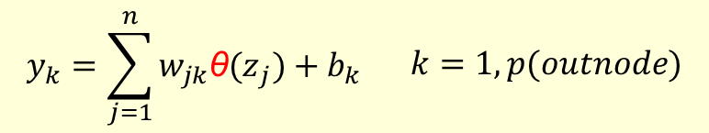
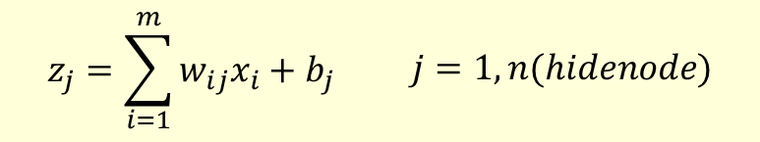
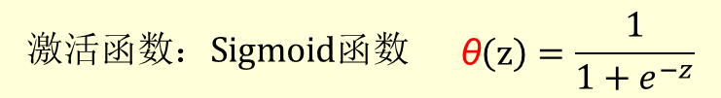
正向传播过程
void __fastcall Bp_Fully_Conne_Fprop(BP_Layer *prelay, BP_Layer *curlay) //正向传播::全连接层
{ int preNum = prelay->nodeNum;
double *preS0 = prelay->pData;
int curNum = curlay->nodeNum;
double *Wij = curlay->W; //连接权值
double *b0j = curlay->b; //阈值
double *curS0 = curlay->pData;
int jj,ii;
double sum,z0;
for(jj = 0;jj < curNum;jj++)
{ sum = 0.0;
for(ii = 0;ii < preNum;ii++) sum += Wij[ii*curNum + jj]*preS0[ii]; //隐含层各单元输入激活值
z0 = sum + b0j[jj]; //隐含层激活值
curS0[jj]= ActivateFunc(z0);} //隐含层各单元的输出
return;}
$$激活函数：Sigmoid函数\begin{matrix} & \text{θ}\left(z\right)=\frac{1}{1+e^{−z}}\end{matrix}$$
$$z_{j}=\sum_{i=1}^{m}{w_{ij}x_{i}+b_{j}}\begin{matrix} & j=1,n(hidenode)\end{matrix}$$
$$y_{k}=\sum_{j=1}^{n}{w_{jk}{\text{θ}(z}_{j})+b_{k}}\begin{matrix} & k=1,p(outnode)\end{matrix}$$

Slide 11
反向传播过程
void __fastcall BpNet :: BpNetTrainFunc(double InSam[trainsample][BpInNode],double OutSam[trainsample][BpOutNode])//训练
{//3.误差反向传播:: 对于网络中每个输出单元，计算误差项，并更新权值
//3.1 输出层->隐含层[第2层]
sum = 0;
for(jj = 0;jj < BpOutNode;jj++) { z0 = Outyd[jj] - Outy0[jj];out_Er[jj] = z0;sum += z0*z0;}//计算总均方差
totalErr += sum / 2.0;
for(jj = 0;jj < BpOutNode;jj++)
{ out_Er[jj] = out_Er[jj] * Outy0[jj] * (1. - Outy0[jj]); //输出层δ2 = ei * θ'(si2) 期望误差*输出层Outy0激励函数导数
for(ii = 0;ii < BpHideNode;ii++) ho_w[ii][jj] += rate_ho_w * out_Er[jj]*Hides0[ii];}//更新隐含层和输出层之间的连接权
for(jj = 0;jj < BpOutNode; jj++) Out_b0[jj] += rate_Out_b0 * out_Er[jj]; //更新隐含层和输出层之间的阈值
//3.2 隐含层->输入层[第1层]
for(jj = 0;jj < BpHideNode;jj++)
{ sum = 0.0;
for(ii = 0;ii < BpOutNode;ii++) sum += out_Er[ii] * ho_w[jj][ii];
hideEr[jj] = sum * Hides0[jj]*(1. - Hides0[jj]); //隐含层δ1 = （∑out_Er *ho_w） * θ'(si2) 隐含层误差*隐含层Hides0激励函数导数
for(ii = 0;ii < BpInNode;ii++) ih_w[ii][jj] += rate_ih_w * hideEr[jj] * In_x0[ii];} //更新输入层和隐含层之间的连接权[权重梯度]
for(jj = 0;jj < BpHideNode;jj++) Hideb0[jj] += rate_Hideb0 * hideEr[jj]; //更新输入层和隐含层之间的阈值
}
反向传播过程是这样的:
输出层每个节点都会得到一个误差e，把e作为输出层反向输入，这时候就像是输出层当输入层一样把误差往回传播，先得到输出层δ，然后将输出层δ根据连接权重往隐层传输，即前面的式子：

Slide 12
3层结构：
void __fastcall Bp3_BackwardPropagation(int nv,double Outyd[]) //反向传播过程
Bp_Calculate_Delta2_Func( &BpOutLay, Outyd); //计算输出层δ2[输出层->隐含层]
Bp_Calculate_Deltaj_Func( &BpOutLay, &BpHideLay);
Bp_Update_Weight_Wj_Func(&BpOutLay, &BpHideLay);//更新权值
Bp_Update_Weight_Wj_Func(&BpHideLay, &BpInLay);}
4层结构：
void __fastcall Bp4_BackwardPropagation(int nv,double Outyd[]) //反向传播过程
Bp_Calculate_Delta2_Func( &BpOutLay, Outyd); //计算输出层δ2[输出层->隐含层]
Bp_Calculate_Deltaj_Func( &BpOutLay, &BpHid2Lay);
Bp_Calculate_Deltaj_Func( &BpHid2Lay, &BpHideLay);
Bp_Update_Weight_Wj_Func(&BpOutLay, &BpHid2Lay);//更新权值
Bp_Update_Weight_Wj_Func(&BpHid2Lay, &BpHideLay);
Bp_Update_Weight_Wj_Func(&BpHideLay, &BpInLay);}

Slide 13
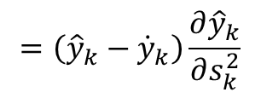
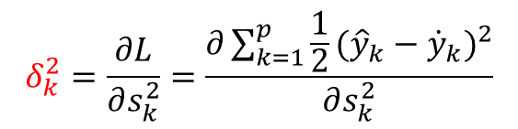
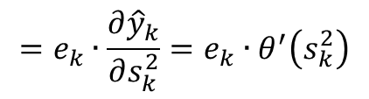
计算 δ2
//反向传播::计算 δ2 及 总均方差
void __fastcall Bp_Calculate_Delta2_Func(BP_Layer *curlay, double *Outyd)
{ int outnum = curlay->nodeNum;
double *Outy0 = curlay->pData; //结点状态值
double *Delta = curlay->Delta; //偏差 Weight
int jj,ii;
double sum,ej;
sum = 0;
for(jj = 0;jj < outnum;jj++)
{ ej = Outyd[jj] - Outy0[jj];sum += ej*ej;Delta[jj] = ej * dActivateFun(Outy0[jj]);}
//输出层δ2 = ei * θ'(si2) 期望误差*输出层Outy0激励函数导数
AnntotalErr += sum / 2.0; //计算希望输出与实际输出的偏差ej和总均方差sum
return;}
$$δ_{k}^{2}=\frac{∂L}{∂s_{k}^{2}}=\frac{∂\sum_{k=1}^{p}{\frac{1}{2}{({\hat{y}}_{k}−{\dot{y}}_{k})}^{2}}}{∂s_{k}^{2}}$$
$$=\left({\hat{y}}_{k}−{\dot{y}}_{k}\right)\frac{∂{\hat{y}}_{k}}{∂s_{k}^{2}}$$
$$=e_{k}∙\frac{∂{\hat{y}}_{k}}{∂s_{k}^{2}}=e_{k}∙θ^{′}\left(s_{k}^{2}\right)$$

Slide 14
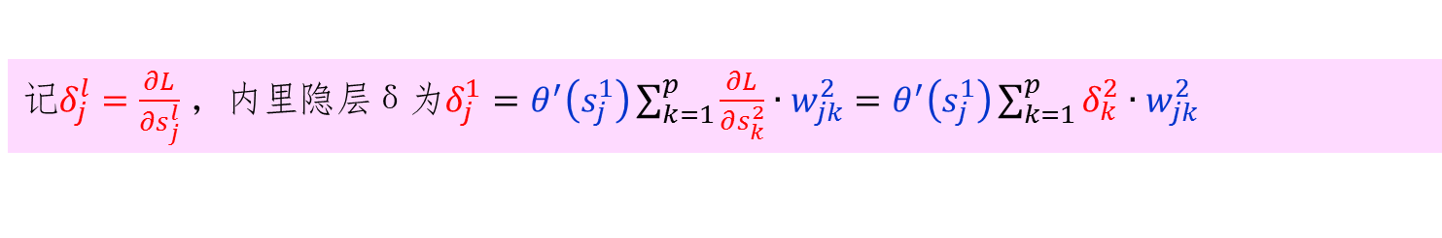
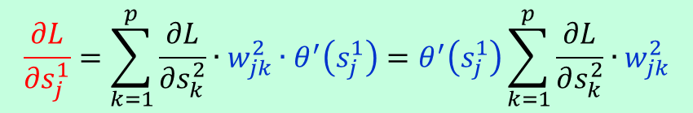
计算 δ1
//反向传播::计算 δ1
void __fastcall Bp_Calculate_Deltaj_Func(BP_Layer *curlay, BP_Layer *prelay)
{ int prenum = prelay->nodeNum;
double *ps0 = prelay->pData; //结点状态值
double *Deltaj = prelay->Delta; //偏差 Deltaj
int curnum = curlay->nodeNum;
double *Delta2 = curlay->Delta; //偏差 Delta2
double *wij = curlay->W; //连接权值
int jj,kk;
double sum;
for(jj = 0;jj < prenum;jj++) { sum = 0.0;
for(kk = 0;kk < curnum;kk++) sum += Delta2[kk] * wij[jj*curnum+kk];
Deltaj[jj] = sum * dActivateFun(ps0[jj]);}
//隐含层δ1 = （∑curErr *wij） * θ'(si2) 隐含层误差*隐含层ps0激励函数导数
return;}
$$\frac{∂L}{∂s_{j}^{1}}=\sum_{k=1}^{p}{\frac{∂L}{∂s_{k}^{2}}∙w_{jk}^{2}∙θ^{′}\left(s_{j}^{1}\right)}=θ^{′}\left(s_{j}^{1}\right)\sum_{k=1}^{p}{\frac{∂L}{∂s_{k}^{2}}∙w_{jk}^{2}}$$
记$δ_{j}^{l}=\frac{∂L}{∂s_{j}^{l}}$，内里隐层δ为$δ_{j}^{1}=θ^{′}\left(s_{j}^{1}\right)\sum_{k=1}^{p}{\frac{∂L}{∂s_{k}^{2}}∙w_{jk}^{2}}=θ^{′}\left(s_{j}^{1}\right)\sum_{k=1}^{p}{δ_{k}^{2}∙w_{jk}^{2}}$

Slide 15
更新权值
//反向传播::更新权值
void __fastcall Bp_Update_Weight_Wj_Func(BP_Layer *curlay, BP_Layer *prelay)
{ int prenum = prelay->nodeNum;
double *pS0 = prelay->pData; //结点状态值
int curnum = curlay->nodeNum;
double *Deltaj = curlay->Delta; //偏差
double *wij = curlay->W; //连接权值
double *b0j = curlay->b; //阈值
float rate_w = curlay->rate_w; //权值学习速率
float rate_b = curlay->rate_b; //阈值学习速率
int jj,ii;
for(jj = 0;jj < curnum;jj++) {
//更新输入层和隐含层之间的连接权[权重梯度]
for(ii = 0;ii < prenum;ii++) wij[ii*curnum+jj] += rate_w * Deltaj[jj] * pS0[ii];
//更新输入层和隐含层之间的阈值
b0j[jj] += rate_b * Deltaj[jj];}
return;}

